Slide 1
UNIT- 6 BACKUP AND RECOVERY
CHERM
CLASS : 10 (ENGINEERING)

Slide 2
6.1. Introduction to Backup and Recovery
BACKUP:
Computer backup is a process that copies all your files, data and information the effectively create two various one on your original and one backup. It is designed to protect all of your important files and pictures. Even the ones you save to an external hard drive. A backup is a copy of important data that is made on a regular basis. The purpose of a backup is to ensure that the data can be restored in case of data loss or system failure. Backups can be used to restore a single file, an entire system, or entire network.

Slide 3
RECOVERY:
In computers, recovery refers to the process of restoring a system, application, or data to a functional or original state after experiencing a failure, error, or loss. Recovery ensures continuity and minimizes the impact of problems like hardware malfunctions, software errors, or accidental deletions.
Types of Recovery:
1. Data Recovery: Data recovery involves retrieving lost, deleted, or corrupted files from storage devices like hard drives, SSDs, USB drives, or memory cards. Common causes for data loss include accidental deletion, formatting, malware attacks, or hardware failures.. Preventive measures such as regular backups and using reliable storage devices can significantly reduce the need for data recovery.

Slide 4
2. System Recovery: System recovery focuses on restoring an operating system (OS) to a functional state after crashes, malware attacks, or update failures. This is done through methods like booting into recovery mode, or reinstalling the OS. Many systems come with built-in recovery tools, such as Windows Recovery Environment or macOS Recovery.
3. Database Recovery : Database recovery restores a database to a consistent and usable state after a failure, such as power outages, software bugs, or disk crashes. Recovery relies on techniques like restoring backups, replaying transaction logs, or using checkpoints.

Slide 5
4. Disaster Recovery
Disaster recovery refers to strategies for maintaining or restoring IT infrastructure and operations after catastrophic events such as natural disasters, cyberattacks, or system failures. This involves having backups, redundant systems, and failover mechanisms, often supported by cloud-based recovery solutions
5. Password Recovery
Password recovery is the process of resetting or retrieving forgotten passwords for accounts or encrypted files. Tools like password recovery utilities, security questions, or two-factor authentication help users regain access. Many systems offer "Forgot Password" options to reset credentials securely.

Slide 6
6.Cloud Recovery
Cloud recovery is the process of restoring data, applications, or systems stored in the cloud to ensure business continuity after a failure, cyberattack, or disaster. It leverages cloud-based backup and disaster recovery solutions to quickly recover lost or corrupted information without the need for physical infrastructure.
Backup Methods:
A backup method refers to the specific approach or strategy used to create and store copies of data for protection against loss, corruption, or disasters. Each method balances storage space, recovery speed, and data integrity based on specific needs.Various backup methods are: full backup, incremental backup,differential backup,mirror backup,cloud backup, local backup etc.

Slide 7
Full backup:
A full backup involves creating a complete copy of all data, regardless of changes since the last backup. This method is comprehensive and provides a straightforward recovery process, as all data is stored in a single location. However, it requires significant time and storage space, making it less suitable for frequent backup. Example: A company performs a full backup of its database every Sunday night, storing the complete data set on an external hard drive to ensure data integrity for the week ahead.
Advantages:
Complete data protection
Faster recovery
Disadvantages:
a. Full backups require a large amount of storage
b. The process of creating a full backup can take a long time

Slide 8
2. Incremental Backup:
An incremental backup only copies the data that has changed since the last backup (whether full or incremental). It is efficient in terms of storage and time but can complicate recovery, as multiple incremental backups must be restored in sequence. Example: After performing a full backup on Sunday, a business runs daily incremental backups, saving only the files updated on Monday, Tuesday, and so on. This reduces backup time and storage requirements.
Advantages:
a. Faster Backup Process
b. Less Storage Space
Disadvantages:
a. Slower Recovery Time
b. Risk of Data Loss

Slide 9
3. Differential Backup
A differential backup saves all changes made since the last full backup. Unlike incremental backups, differential backups grow larger over time as they accumulate all changes since the last full backup. While this simplifies recovery, as only the full and most recent differential backups are needed, it requires more storage than incremental backup. Example: After a full backup on Sunday, a differential backup on Wednesday includes changes from Monday, Tuesday, and Wednesday. If recovery is needed, only the Sunday full backup and the Wednesday differential backup are required.
Advantages of Differential Backup:
a. Faster recovery (only need the last full and differential backups).
b. Less storage than full backup (stores only changes since the last full backup).
Disadvantages of Differential Backup:
a. Larger size over time (grows as more changes are included).
b. Longer backup time than incremental (includes all changes since the last full backup).

Slide 10
4. Mirror Backup
A mirror backup creates an exact replica of the source data, including any deletions or changes. It is useful for maintaining an up-to-date copy but carries the risk of accidental deletions being mirrored to the backup. Example: A graphic designer uses a mirror backup to keep a real-time copy of their project files on a secondary external drive. If a file is modified or deleted, the change is immediately reflected in the backup.

Slide 11
5. Cloud Backup
A cloud backup involves storing data on remote servers managed by third-party providers. This method offers scalability, accessibility from any location, and protection against local disasters. However, it depends on a stable internet connection and often incurs recurring costs. Example: A small business uses Google Drive to back up its financial records daily, ensuring the data is safe and accessible even if the local office systems fail.
6. Local Backup
A local backup involves saving data to physical storage devices like external hard drives, USB drives etc. It is faster for both backups and recovery compared to cloud backups but is susceptible to risks like hardware failures, theft, or physical damage. Example: A photographer backs up their portfolio to an external SSD after every photoshoot, ensuring quick access to their files in case of a laptop failure.

Slide 12
Different between incremental backup and differential backup
Incremental Backup | Differential Backup
Backs up only the data that has changed since the last backup (full or incremental). | Backs up all data that has changed since the last full backup.
Requires less storage space for each backup compared to differential backups. | Requires more storage space as changes accumulate since the full backup.
Backup process is faster because it only captures the most recent changes. | Backup process becomes slower over time as it includes all changes since the last full backup.
Recovery is slower because multiple incremental backups must be restored in sequence. | Recovery is faster since only the last full backup and the latest differential backup are needed.
Ideal for frequent backups with minimal storage requirements. | Better for situations where quicker recovery is prioritized over storage efficiency.

Slide 13
Backup devices and media
Backup devices and media are the hardware and storage formats used to save copies of data for protection against loss. They vary in capacity, speed, portability, and durability, allowing users to choose based on their backup needs.
There are various backup devices and media that can be used to store backups, including:
1.External hard drives: These are small, portable devices that can store a large amount of data and can be easily connected to a computer via USB or other types of connections.
2. Cloud storage services: These are online storage services that can be used to store backups and other types of data. Examples include Amazon S3, Google Drive, and Microsoft Azure.

Slide 14
3. Tape drives: These are devices that can store data on magnetic tape and are commonly used for long-term storage and disaster recovery backups.
4.Optical media: These are devices that store data on CDs, DVDs, or Blu-ray discs and are commonly used for archival backups or for backups that need to be stored off-site.
5. USB Flash Drives :USB flash drives are small and easy to carry, making them perfect for storing a small amount of data, like documents or photos.
6. Internal Backup Drives
Internal backup drives are hard drives placed inside your computer to store extra copies of your files. These drives are fast and always connected to your computer.

Slide 15
7. Memory Cards (SD Cards)
Memory cards are tiny, portable storage devices often used in cameras and phones. They are good for saving smaller files, like photos, videos, and music.
8. RAID Systems
RAID (Redundant Array of Independent Disks) is a setup where multiple hard drives work together to store data safely. If one drive fails, the others keep the data safe.

Slide 16
Backup scheduling
It is the process of automating the timing of backups to ensure that your data is regularly and reliably copied without needing manual intervention. This is especially important for both personal and business environments, where data loss can be catastrophic. Backup scheduling ensures that your files are backed up consistently and at optimal times, such as overnight or during periods of low activity, without interrupting your daily tasks.

Slide 17
Why Backup Scheduling is Important:
Automates the Process: You don't need to remember to run backups manually. Scheduling automates the process, making it a regular part of your routine.
Prevents Data Loss: Regular backups minimize the risk of losing important files, whether due to accidental deletion, hardware failure, malware, or other disasters.
Optimizes System Performance: You can schedule backups to run during periods of low computer or network usage (like at night), so they don’t interfere with work hours.

Slide 18
Media Rotation:
Media rotation is the process of backed up data in different location or medias, it mean if we kept our data in hard drive after some time we kept same data into another device. This system Rotating your data in different storage devices or medias
The goal of media rotation is to provide multiple copies of data, so that in case of a failure or loss of the primary backup, there are other copies of data that can be used for recovery.
Important of Media rotation :
We can recover data even primary copy is lost.
We can recover data from another devices due to disaster damaged of primary data.
Reduce risk of data corruption.

Slide 19
RAID System:
A raid system generally refers to a Redundant Array of Independent Disks (RAID), a technology used in computing to combine multiple physical disk drives into a single logical unit. This configuration is aimed at improving performance, increasing storage capacity, and ensuring data redundancy. RAID systems are widely used in both personal computing and enterprise environments, particularly in scenarios where reliability, speed, and storage efficiency are crucial.
RAID level
A RAID level refers to a specific configuration of multiple disk drives that define how data is distributed, mirrored, or striped across the drives in an array. Each RAID level offers a different balance of performance, data redundancy, and storage capacity. Below are the most commonly used RAID levels:

Slide 20
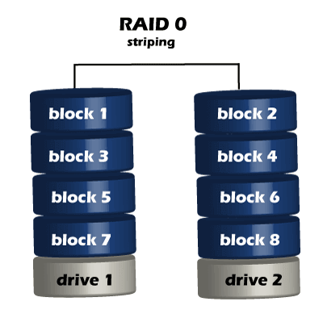
RAID 0(Striping)
In this level Data is split across two or more drives. It will increase speeds as you're reading and writing from multiple disks at a time where all disk are perform parallelly. But all data on all disks is lost if any one disk fails. The main purpose of RAID 0 is boost speed of R/W data.

Slide 21
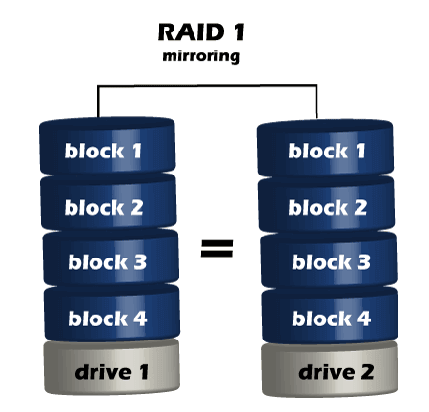
2. RAID 1 (Mirroring)
In this level Data is copied exactly to two or more drives (mirrored). If one drive fails, you still have an exact copy of your data on the other drive.
Pros: Excellent data protection (redundancy).
Cons: Storage capacity is halved because the same data is written to both drives.

Slide 22
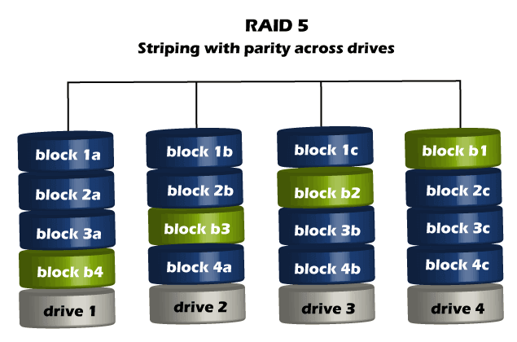
3. RAID 5 (Striping with single Parity):
RAID 5 requires the use of at least three drives. It combines these disks to protect data against loss of any one disk. It strips data across multiple drives to increase performance.
Pros: Good speed and data protection with more efficient storage than RAID
Cons: Slower write speeds due to parity calculations.

Slide 23
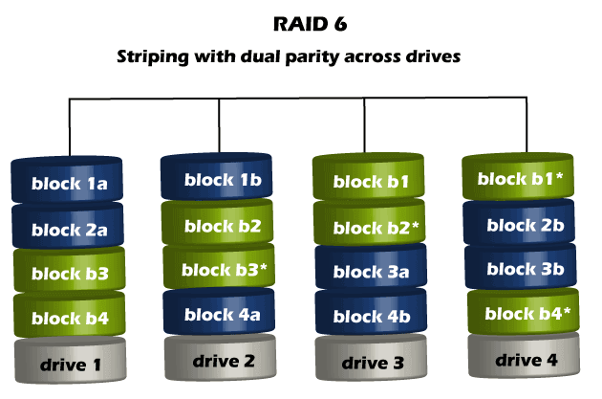
4. RAID 6 (Striping with Double Parity):
In this level Data is striped across multiple drives, and two sets of parity data are stored. This allows for data recovery even if two drives fail.
Pros: Higher protection than RAID 5.
Cons: Slower write speeds due to double parity, and requires at least 4 drives.

Slide 24
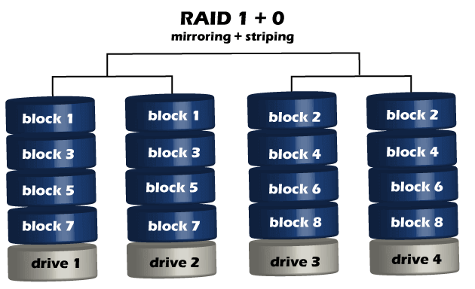
5. RAID 10 (1+0)
This level Combines RAID 1 and RAID 0 in a single system, which offers higher performance than RAID 1, but at a much higher cost. This is a nested or hybrid RAID configuration. It provides security by mirroring all data on secondary drives while using striping across each set of drives to speed up data transfers.

Slide 25
Recovery techniques
Recovery techniques in computers refer to the various methods used to restore data, repair systems, or recover from failures. These techniques help to fix issues that may arise due to hardware failure, software corruption, accidental data loss, or malware attacks. Below are some common recovery techniques in computer systems:
1. System Restore
System Restore allows users to return their computer to a previous working state by using restore points that Windows automatically creates or that the user manually sets. This technique helps fix problems caused by recent changes (like software installations or updates).
When software issues arise, such as after installing a problematic update or program, causing system instability or crashes we need to use system restore technique.

Slide 26
2. Data Backup and Restore
Regular backups are critical for data recovery. Backup solutions include full, incremental, or differential backups, often stored on external drives or cloud services. When data is lost or corrupted, backups can be restored to recover important files.
Common tools: Time Machine (macOS), Windows Backup, cloud services (Google Drive, OneDrive, Dropbox)
3. File Recovery Software
File recovery software can scan storage devices for deleted or lost files and attempt to recover them, even if they are no longer visible in the file system.
When to use: When files are accidentally deleted, formatted, or become inaccessible due to corruption.
Common tools: EaseUS Data Recovery Wizard, Disk Drill, PhotoRec.

Slide 27
4. Disk Repair Tools
Disk repair tools scan and fix errors in the file system or physical disk. These tools can correct problems like bad sectors or file system inconsistencies that prevent the system from booting or accessing files.
Common tools:
a.CHKDSK (Windows): Scans and repairs the file system and checks for bad sectors. b. fsck (Linux): File system check and repair tool. c.Disk Utility (macOS): Includes disk repair features.

Slide 28
5. Bootable Recovery Media
Bootable recovery media (like a USB stick or external drive) contains a recovery environment and essential tools to repair a broken or unbootable system. If a computer cannot start due to OS corruption or malware, bootable media can be used to fix issues, reinstall the OS, or recover data.
Common tools: Windows Recovery Drive, macOS Recovery Mode, Linux Live CD etc.

