Slide 1
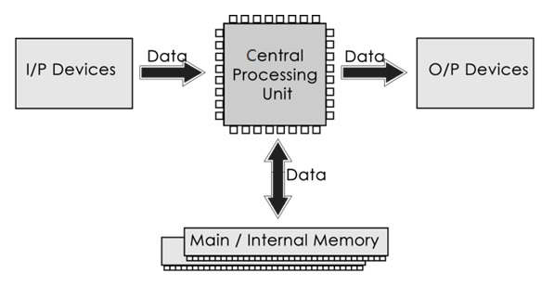
UNIT- 2 BASIC OF COMPUTER SYSTEM
Introduction to Basic Components of Computer System
Computer systems consist of three components as shown in below image: Central Processing Unit, Input devices and Output devices. Input devices provide data input to processor, which processes data and generates useful information that's displayed to the user through output devices. This is stored in computer's memory.

Slide 2
UNIT- 2 BASIC OF COMPUTER SYSTEM
Input Unit:
Input unit provides an interface between user and machine, for inputting data and instruction into the computer memory. Input unit accepts input, converts it into computer readable format and provides it for processing and storage.
Input Devices:
The devices that are used to enter data and instructions or commands into the computer are called input devices. The input devices can be considered as the eyes and ears of computers. The most popular input devices are as follows:

Slide 3
UNIT- 2 BASIC OF COMPUTER SYSTEM
Keyboard:
The keyboard is the most commonly used input device in the personal computer. It is used to feed data and instructions into a computer. A keyboard contains keys for each alphabetic characters, numbers, special characters and some additional keys for specific functions. A standard keyboard has 104 keys. There are 12 function keys in keyboard. The data and instructions are feed into the computer by pressing the related keys on the keyboard.
Keyboard Key Categories (Shortened):
Alphanumeric Keys: Letters (A-Z), Numbers (0-9), Symbols (!, @, #).
Modifier Keys: Shift, Ctrl, Alt, AltGr, Fn.
Function Keys: F1–F12 (e.g., F1 for help, F5 to refresh).
Navigation Keys: Arrows, Home, End, Page Up/Down, Insert, Delete.
Control Keys: Esc, Print Screen, Pause/Break.
Numeric Keypad: Numbers and math symbols (on full-size keyboards).
Special Keys: Tab, Caps Lock, Enter, Backspace, Spacebar.

Slide 4
UNIT- 2 BASIC OF COMPUTER SYSTEM
B) Mouse:
The mouse is the most commonly used pointing input device in the personal computer. It is used to point object and give commands to the computer. When you move the mouse on the mouse pad, the mouse pointer on the screen moves in the corresponding direction. Types of mouse
Mechanical Mouse: Uses a ball for movement detection.
Optical Mouse: Uses an LED light and a sensor for tracking.
Laser Mouse: More precise, uses a laser for tracking.
C) Scanner:
A scanner is an input device that optically scans images, printed text, handwriting, or an object and converts it to a digital and then sends to the computer.

Slide 5
UNIT- 2 BASIC OF COMPUTER SYSTEM
D) Digital Camera:
A digital camera is a hardware device that takes photographs and stores the image as data on a memory card. A digital camera is a camera that produces digital images that can be stored on a computer, displayed on a screen, and printed.
Why digital camera is called input/output device?
A digital camera is considered both an input and output device because it performs functions that align with both categories. As an input device, it captures photographs and videos by converting light into digital data, allowing it to gather information from the external environment. This data can then be transferred to computers or other devices for processing, storage, or editing. On the other hand, the digital camera also functions as an output device by displaying captured images and videos on its screen for review or playback. Additionally, it can send stored media to external devices, such as printers or computers, making it an output medium. This dual capability of capturing and transferring or displaying data justifies the classification of a digital camera as both an input and output device.

Slide 6
UNIT- 2 BASIC OF COMPUTER SYSTEM
Introduction to processing unit: ALU & Control Unit [SEE 2081]
The part of a computer that performs logical and arithmetical operations on the data as specified in the instructions. A central processing unit (CPU), also called a central processor, main processor or just processor, is the electronic circuitry that executes instructions comprising a computer program. The CPU performs basic arithmetic, logic, controlling, and input/output (I/O) operations specified by the instructions in the program.
There are three segments of CPU(processor) are as follows:
Arithmetic-Logic Unit:
An arithmetic-logic unit is the part of a central processing unit that carries out arithmetic and logic operations on the operands in computer instruction words. In some processors, the ALU is divided into two units: an arithmetic unit (AU) and a logic unit (LU). Responsibilities:Arithmetic operations (e.g., addition, subtraction).Logical comparisons (e.g., AND, OR, NOT).Analogy: Functions like a calculator performing computations and checks.

Slide 7
UNIT- 2 BASIC OF COMPUTER SYSTEM
2.Control Unit (CU)
Function: Directs the operation of the processor by interpreting instructions and controlling the flow of data between other sections of the CPU and peripherals.
Responsibilities: Fetching instructions from memory. Decoding instructions. Managing signals to coordinate tasks.
Analogy: Acts like a traffic cop directing cars at an intersection.
3. Registers:
A processor register (CPU register) is one of a small set of data holding places that are part of the computer processor
Function: Small, high-speed storage locations inside the CPU used to hold temporary data, instructions, or addresses.
Types:
General-purpose registers: Used for temporary storage during calculations.
Special-purpose registers: Includes program counter (PC), instruction register (IR), stack pointer (SP), and accumulator (ACC).
Analogy: Like sticky notes for quick reference during a task.

Slide 8
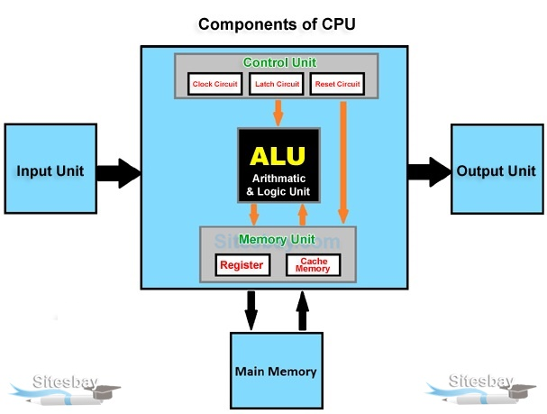
UNIT- 2 BASIC OF COMPUTER SYSTEM

Slide 9
UNIT- 2 BASIC OF COMPUTER SYSTEM
Introduction to Display unit: Monitor Resolution, color and refresh rate, CRT, LCD and LED:
Display Unit:
Display unit provides the result after processing the data to the users. It provides the output into user understandable format before providing it to the users. The output generated by the computer is of two types' hardcopy and softcopy.
The result of processing is called output. Output devices receive the information from computer and provide them to the user. We can see the output on a screen, pint it on the printer or hear it through speakers. The devices that are used to get output from the computer are called output devices.
Monitor:
The monitor is a popular and most commonly used output device. The monitor consists of a screen and the electronic components that produce the output on the screen for a temporary period. It is also called Visual Display Unit (VDU) that provides visual display. The output received on the monitor screen is called softcopy output.

Slide 10
UNIT- 2 BASIC OF COMPUTER SYSTEM
Monitor resolution
Monitor resolution describes the virtual dimensions of any given display. Expressed in terms of width and height, monitor resolution in comprised of a specific number of pixel.
Common Monitor Resolutions
1.HD (High Definition):
720p (1280 × 720): Often used in small monitors and budget laptops. It offers basic clarity but lacks the sharpness for detailed work or high-end gaming.
2.Full HD (FHD):
1080p (1920 × 1080): The standard for most monitors and TVs. It balances clarity and performance, making it suitable for gaming, video editing, and general use.
3. 2K: 1440p (2560 × 1440): Provides greater detail than 1080p, ideal for gamers and professionals who need higher resolution for better clarity and more screen real estate.

Slide 11
UNIT- 2 BASIC OF COMPUTER SYSTEM
4. Ultra HD (UHD) or 4K:
2160p (3840 × 2160): Four times the resolution of 1080p, offering exceptional clarity. It's perfect for high-end gaming, professional video editing, and large displays.
5. 8K:
4320p (7680 × 4320): The cutting edge of display technology, providing unparalleled detail. Currently, it is more common in high-end TVs and specialized professional monitors due to its high cost and the need for powerful hardware to support it.

Slide 12
UNIT- 2 BASIC OF COMPUTER SYSTEM
Monitor color
Most video cards have several different operating modes. Each mode has a different number of colors. For example, the most basic mode in windows is mode called "VGA" which has a resolution of 640 by 480 and 16 colors. This means that the display has 640 pixel horizontally, 480 pixel vertically and display no more than 16 colors at a one time. Other common resolution includes 800x600, 1024x768 and 1280x1024. Other color common modes include 256 colors, 65536 colors and 16 million colors.
Monitor refresh rate:
The refresh rate of a display is the number of times per second that the image refreshes on the screen. For example, a 60Hz display will update the screen 60 times per second.
Overall, the refresh rate determines how smoothly motion appears on your screen. For example, if you’re playing a game that has a lot of fast-moving action, a higher refresh rate can help improve your overall gaming experience to keep up with the action.

Slide 13
UNIT- 2 BASIC OF COMPUTER SYSTEM
How to change the refresh rate
Select the Start button, then select Settings > System > Display > Advanced display settings.
Under Refresh rate, select the rate you want. The refresh rates that appear depend on your display and what it supports. Select laptops and external displays will support higher refresh rates.
CRT Monitor:
It stands for "Cathode Ray Tube", CRT is the technology used in traditional computer monitors and television. The cathode ray tube (CRT) is a vacuum tube that contains one or more electronic guns and used to display images.
The image on a CRT display is created by firing electrons from the back of the tube to phosphorus located towards the front of the display. Once the electrons hit the phosphorus they light up and are projected on the screen. This color you can see in the screens produced by a blend of red, blue & green light.

Slide 14
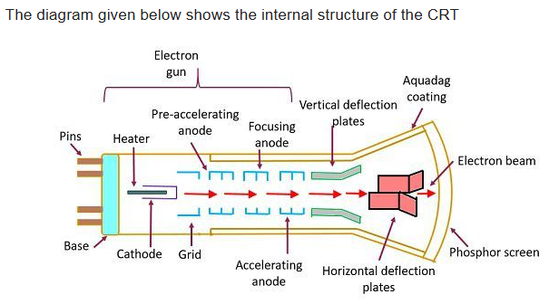
UNIT- 2 BASIC OF COMPUTER SYSTEM

Slide 15
Working mechanism of CRT monitor:
A Cathode Ray Tube (CRT) monitor operates by using electron beams to create images on a phosphorescent screen. Inside the monitor, an electron gun emits streams of electrons, which are accelerated and directed towards the screen through electric fields. The electron beams are focused into precise points using focusing anodes, ensuring accuracy when they strike the screen. Electromagnetic coils surrounding the neck of the CRT generate magnetic fields to deflect the beams horizontally and vertically, allowing them to scan the screen in a systematic pattern known as raster scanning. The screen is coated with phosphor dots that emit light when struck by electrons, creating the visible image. In color CRTs, these phosphors are arranged in triads of red, green, and blue, corresponding to the primary colors of light. The monitor controls the intensity of the beams to vary the brightness of each color, enabling a wide range of colors to be displayed. This process is repeated many times per second (refresh rate) to produce a stable and flicker-free image. While CRT monitors are known for their rich color reproduction and wide viewing angles, they are bulky, consume significant power, and are prone to screen burn-in over time.

Slide 16
LCD Monitor:
The full form of LCD is Liquid Crystal Display. It uses special kind of liquid crystal to display video and graphics on the screen. It consumes very less power than CRT monitor. It is very lighter and more portable than the CRT monitor. The biggest advantage of LCD monitor is their size and weight. LCD screen also tends to produce less eye fatigues to the user. Another advantage of LCD screen is its fixed resolution.
LED Monitor:
The full form of LED is Light Emitting Diodes. LED is the advance application of LCD. It is better than the LCD technology. Due to the better techniques used in the LED monitors, these monitors are very accurate in their color display. The contrast ratio of LED monitors is much better than that of the LCD monitors. The viewing angle of LCD monitors is not flexible and the viewers are required to see the LCD monitors from an angle of 30 degrees. Any change in this viewing angle can diminish the quality of the picture t a greater extend.

Slide 17
Here’s a concise comparison in tabular form:
Aspect | CRT Monitor | LCD Monitor
Size and Weight | Bulky and heavy | Slim and lightweight
Power Consumption | High | Low
Display Technology | Electron beams and phosphors | Liquid crystals and backlight
Resolution | Variable, fixed resolution | Native resolution
Viewing Angle | Wide | Limited in older models, improved in newer ones
Color Quality | Deep colors, high contrast | Sharper image, may have less depth in colors
Durability | Prone to burn-in | No burn-in issues
Motion Blur | Minimal | Possible in older models, improved in newer ones
Environmental Impact | Contains hazardous materials | More eco-friendly and easier to recycle
Space Requirement | Requires more space | Compact and space-saving

Slide 18
Here’s a comparison between LED and LCD monitors
Aspect | LED Monitor | LCD Monitor
Full Form | Light Emitting Diode | Liquid Crystal Display
Backlighting | Uses LED backlight | Uses fluorescent backlight (CCFL)
Power Consumption | More energy-efficient | Consumes more power due to CCFL backlighting
Brightness | Higher brightness and better contrast | Lower brightness compared to LED
Thickness | Thinner and more compact | Thicker due to CCFL backlighting
Color Accuracy | Better color accuracy and deeper blacks | Less vibrant colors and contrast
Lifespan | Longer lifespan | Shorter lifespan compared to LED

