Slide 1
Unit-1 electronic devices
Matter
Any substances, such as a solid, liquid or gas that has weight (mass) and occupies space are called as matter. For anything to occupy space, it must have volume. Based on this, we can say that everything on earth that has weight and takes up some space can be called as matters. Ultimately, everything on earth is matter. Examples of matter are: copper, iron, table, book, Ice, Vapour etc.
Types of matter:
Solid
Liquid
Gas.

Slide 2
Unit-1 electronic devices
Solid:
The hard substances that we see around us are solids. They are hard because of their molecules are packed in very high density. Examples include book, pen, apple, a piece of wood, plastic etc. They are all solids at room temperature. They can exist in different sizes, shapes and forms.
Think of ice cubes as an example. They are solids when frozen. They change into liquid when temperature is above zero degree.
b) Liquid:
The particles in liquids are not as closely bonded, arranged and fixed in place as in solids. The particles in liquid can flow freely and can mix with particles from other liquids. Liquids have their atoms close together, so they are not very easy to compress.

Slide 3
Unit-1 electronic devices
c) Gas:
Gas is everywhere, and it is around us. The air around us is a kind of gas. The atmosphere surrounding the earth is a gas too. Helium, Oxygen, Carbon dioxide and water vapor are all examples of gas.
Molecule
A group of two or more than two atoms of the same or different elements that are chemically bonded together. Examples of molecule are: O2, H2O etc.
Atom
Atom is the smallest particle of an element. Atoms are made up of electrons, neutrons and protons. Examples of atoms are: Hydrogen (H), Iron (Fe) etc.

Slide 4
Unit-1 electronic devices
Atom Vs Molecule [back exam 2080]
S.N. | Atom | Molecule
1 | An atom is the smallest unit of an element. | A molecule is the smallest unit of a compound or element that can exist independently.
2 | Made up of protons, neutrons, and electrons. | Made up of two or more atoms bonded together.
3 | Cannot be divided further in a chemical reaction. | Can be broken into atoms in a chemical reaction.
4 | May or may not exist freely in nature. | Usually exists freely in nature.
5 | Example: Hydrogen (H), Oxygen (O), Carbon (C). | Example: Water (H₂O), Oxygen gas (O₂), Carbon dioxide (CO₂).
6 | Represents a single element. | Can represent either an element (O₂) or a compound (H₂O).

Slide 5
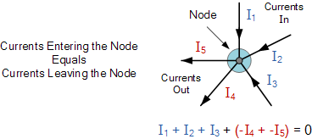
Unit-1 electronic devices
1.2. Introduction of KCL, KVL: [SEE 2080,2081]
Kirchhoff’s Current Law
According to Kirchhoff’s Current Law,
The total current entering a junction or a node is equal to the charge leaving the node as no charge is lost.
In other words the algebraic sum of ALL the currents entering and leaving a node must be equal to zero, I(exiting) + I(entering) = 0.
Current entering the node will be positive and current leaving the node will be negative
Formula: ∑I in​ = ∑I out​

Slide 6
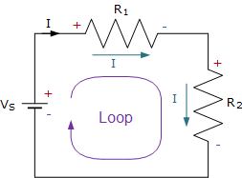
Unit-1 electronic devices
Kirchhoff’s Voltage Law
According to Kirchhoff’s voltage Law,
Statement: The total sum of all voltages around a closed loop in a circuit is equal to zero.In simple words ,Sum of voltage gains and drops in a loop = 0.
Formula: ∑V=0
This means if you go around a complete loop in a circuit, adding up all the voltages (battery voltages, voltage drops across resistors, etc.), the total will be zero.
By KVL in the following circuit.
Vs + (-IR1) + (-IR2) = 0

Slide 7
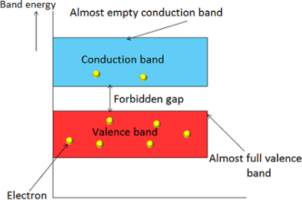
Unit-1 electronic devices
Introduction to Semiconductor material:
The material which has electrical conductivity between that of a conductor and an insulator is called as semiconductor. Silicon, germanium and graphite are some examples of semiconductors.
In semiconductors, the forbidden gap between valence band and
conduction band is very small. It has a forbidden gap of about
1 electron volt (eV). At low temperature, the valence band is
completely occupied with electrons and conduction band is empty
because the electron in the valence band does not have
enough energy to move in to conduction band. Therefore,
semiconductor behaves as an insulator at low temperature.
However, at room temperature some of the electrons in valence
band gains enough energy in the form of heat and moves in to
conduction band.

Slide 8
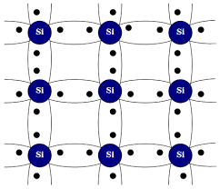
Unit-1 electronic devices
There are two types of semiconductor.
a)Intrinsic semiconductor
b)Extrinsic semiconductor
Intrinsic semiconductor :
A semiconductor where there is no any impurity is doped is
called intrinsic semiconductor. It is pure semiconductor .It
has poor conductivity of electricity. Example of intrinsic
semiconductor is silicon(si), Germanium(ge) etc. It is form
by the tetravalent (having four valence electron ) elements.
At 0 degree temperature there is no any free electron when at
room temperature(25 degree) covalent bond is broken and free electron
is form. Electron move in particular direction and current is produce.

Slide 9
Unit-1 electronic devices
Extrinsic Semiconductor
A semiconductor where impurity is added into pure semiconductor then form extrinsic semiconductor. It has good conductivity. It is two types. They are :
N- type II) P-type
N- type :
When pentavalent (having 5 valence electron) impurity atom such as antimony, phosphorous is added to pure semiconductor (Si, Ge) then N type semiconductor is formed.
Characteristics of N-type Semiconductor:
Majority carriers: Electrons
Minority carriers: Holes
Electrons come from the extra valence electron of the dopant.
Donor level: Energy level just below the conduction band.
Electric current is mainly due to the movement of free electrons.

Slide 10
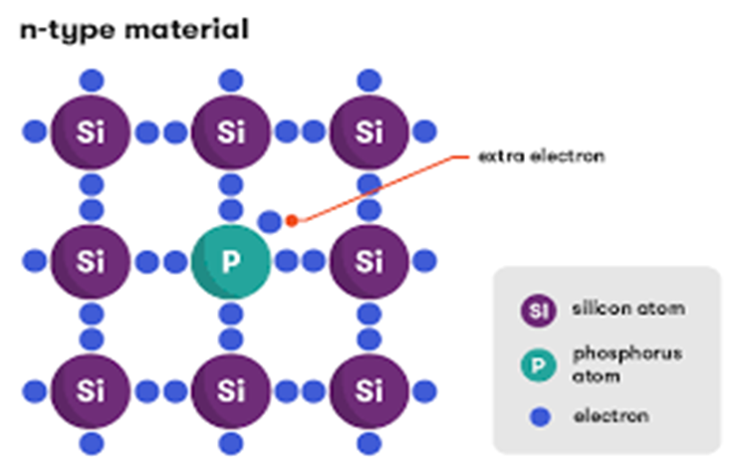
Unit-1 electronic devices
In figure four electron makes bond and one electron is free which produce current.
Majority charge carrier is free electron.

Slide 11
Unit-1 electronic devices
ii) P-type :
A p-type semiconductor is an intrinsic semiconductor doped with trivalent(having three valence electron) impurity atoms . when trivalent impurity(Boron,Almunium) added with silicon & germanium then form p type semiconductor. Look at given figure ,
Trivalent impurity atom is added with Germanium. There is one electron is less that cannot make bond that create holes. When electric field is applied then electron goes to fill the hole. Again, there is another hole is create then other electron comes to fill this hole. This process is continuously happen. Due to this process electron are moving and current is flow. In it holes are majority carrier.

Slide 12
Unit-1 electronic devices
Key Characteristics of P-type Semiconductor:
Feature | Description
🔸 Majority carriers | Holes (absence of electrons)
🔹 Minority carriers | Electrons
🔸 Type of doping | Trivalent impurity (acceptor atoms)
🔹 Movement of charge | Holes move toward the negative terminal under an electric field
🔸 Fermi level | Closer to the valence band
🔹 Current flow | Mostly due to movement of holes

Slide 13
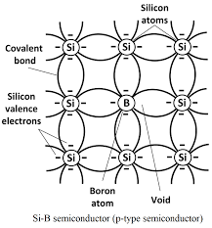
Unit-1 electronic devices

Slide 14
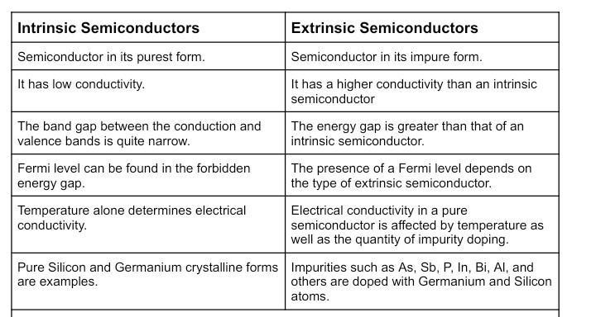
Unit-1 electronic devices

Slide 15
Unit-1 electronic devices
P type | N type
It is accepter type | It is donner type
Impurity atom is trivalent. | Impurity atom is pentavalent
Holes are majority carrier. | Electrons are majority carrier
Also known as trivalent semiconductor. | Also known as pentavalent semiconductor.
Holes are generated | Electron are generated.
Electrons are minority carrier. | Holes are minority carrier.
Doping:
One way to increase conductivity of a semiconductor is by doping. This means adding impurity atoms to an intrinsic crystal to alter its electrical conductivity. A doped semiconductor is called an extrinsic semiconductor.
To increase the conductivity of the semiconductor, doping is done.

Slide 16
Unit-1 electronic devices
Majority and minority charge carriers definition
Majority charge carriers
The charge carriers that are present in large quantity are called majority charge carriers. The majority charge carriers carry most of the electric charge or electric current in the semiconductor. Hence, majority charge carriers are mainly responsible for electric current flow in the semiconductor. In n-type semiconductors: Electrons are the majority carriers because donor impurities (e.g., phosphorus) provide extra free electrons.
In p-type semiconductors: Holes are the majority carriers because acceptor impurities (e.g., boron) create extra holes by accepting electrons.
Majority carriers primarily determine the conductivity of the material.

Slide 17
Unit-1 electronic devices
Minority charge carriers
The charge carriers that are present in small quantity are called minority charge carriers. The minority charge carriers carry very small amount of electric charge or electric current in the semiconductor.
In n-type semiconductors: Holes are the minority carriers (few in number).
In p-type semiconductors: Electrons are the minority carriers.
Minority carriers play a crucial role in devices like diodes and transistors, where recombination and diffusion processes are important.
A diode (mcq SEE 2081)
A diode is a two-terminal electronic component that allows current to flow primarily in one direction, acting as a "one-way valve" for electric current. It is the simplest semiconductor device, formed by joining p-type and n-type materials to create a PN junction.

Slide 18
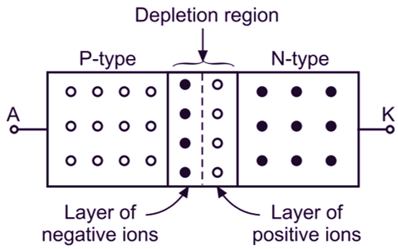
Unit-1 electronic devices
PN junction formation , forward biased and reverse biased
When an n-type semiconductor is joined with the p-type semiconductor, a p-n junction is formed. The region where the p-type and n-type semiconductors are joined is called p-n junction. It is also defined as the boundary between p-type and n-type semiconductor. This p-n junction forms a most popular semiconductor device known as diode. Diode is used for as rectifier in electronic circuits.
P-n junction is also a fundamental building block of
many other semiconductor electronic devices such as
transistors, solar cells, light emitting diodes, and
integrated circuits.
Fig: PN Junction formation

Slide 19
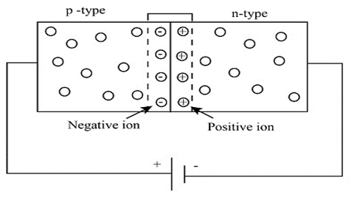
Unit-1 electronic devices
Forward Biased
When V is applied to the PN junction diode from the outside, Connect the P types to the positive terminal and the N type to the negative terminal. Holes in the P-type region and electrons in the N-type region are pushed towards the junction. This will reduce the width of the shrink zone. A PN junction then said to be forward biased.
Forward biasing is essential in rectifier circuits (converting AC to DC), LEDs (which emit light when forward-biased), and transistor operation. Unlike reverse bias, where the diode blocks current, forward bias enables efficient conduction by lowering the junction resistance.

Slide 20
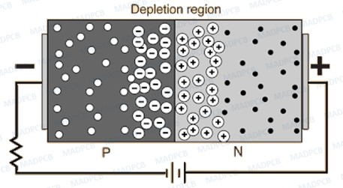
Unit-1 electronic devices
Reverse Biased PN Junction Diode
When a diode is connected in a Reverse Bias condition, a positive terminal of voltage is applied to the N-type material and a negative terminal of voltage is applied to the P-type material.
The positive voltage applied to the N-type material attracts electrons towards the positive terminal of dc source and away from the junction, while the holes in the P-type end are also attracted towards the negative terminal of dc source away from the junction. Reverse biased totally block the flow of current but there is very small amount of current is leakage which is called reverse saturation current. It is used for Voltage Regulation, Photodetectors & Solar Cells V,aractor Diodes, Protection Circuits.

Slide 21
Unit-1 electronic devices
Different between forward and reverse biased :
Forward Biased | Reverse Biased
Allows current to flow easily | Does not allow current to flow easily
Acts like a closed switch | Acts like an open switch
Decreases the width of the depletion region | Increases the width of the depletion region
Diode conducts | Diode does not conduct (except leakage current)
Commonly used in rectification | Commonly used in protection circuits

