Slide 1
Lesson - 3
Overview on System's Core

Slide 2
Introduction to system BIOS
BIOS stands for Basic Input/output System. It is firmware(program stored in ROM) used during the booting process of a computer and provides a low-level interface between the hardware and the operating system. It is found on motherboards that are a pre-installed program on Windows-based computers that executes when a computer is powered up. Before an OS is loaded, the CPU accesses the basic input/output system (BIOS). Then, the next function of BIOS is to examine all the hardware connections and detects all your devices. Mainly it is located on EPROM (erasable programmable read-only memory) chip.
In the early 21st century, BIOS was supplanted by United Extensible Firmware Interface (UEFI), which can handle much larger drives and operate faster than BIOS.

Slide 3
Users can perform different functions by using the BIOS user interface, which is discussed below:
Users can perform hardware configuration
They can select boot drives
They can set the system clock
The BIOS allows users to enable and disable certain system components
To BIOS user interface function, it provides set password prompts for secured access

Slide 4
Function of BIOS
1. Power-On Self-Test (POST): BIOS performs a POST to check the computer's hardware components, such as the CPU, memory, and storage devices, ensuring they are functioning correctly.
2. Boot Loader: BIOS locates and executes the boot loader, a small program that loads the operating system into the computer's memory from the hard drive or another bootable device.
3. Hardware Initialization: BIOS initializes and configures hardware components, such as the keyboard, mouse, and display, to ensure they are ready for use.

Slide 5
4. System Configuration: BIOS provides a setup utility that allows users to configure hardware settings, such as the system clock, boot sequence, and hardware security settings.
5. Firmware Interface: BIOS provides a consistent interface between the operating system and the hardware, allowing the OS to interact with the computer's hardware components.
By performing these functions, the BIOS ensures that the computer's hardware is ready and correctly configured to boot and run the operating system.

Slide 6
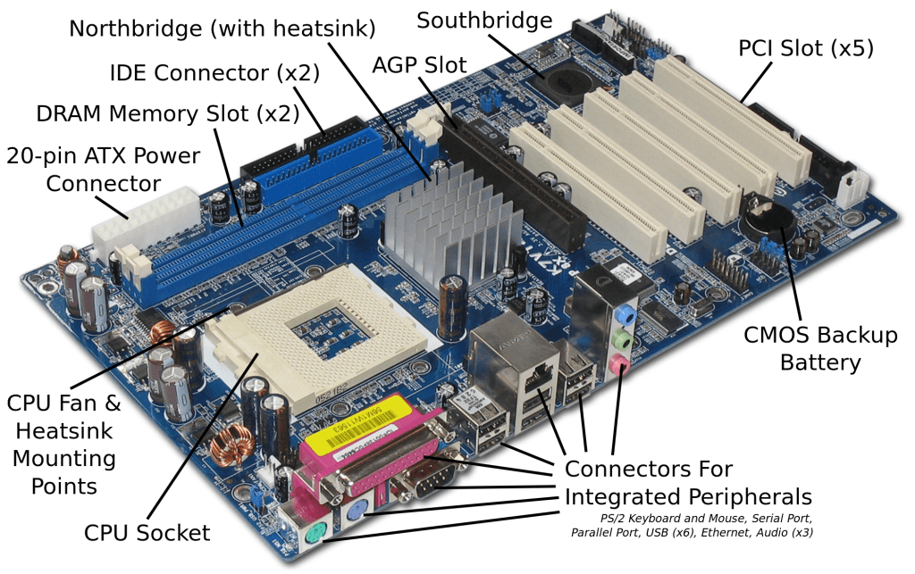
Introduction to Motherboard:
A motherboard, often referred to as the mainboard, system board, or logic board, is the central printed circuit board (PCB) in many modern computers and electronic systems. It holds and allows communication between many of the crucial electronic components of a system, such as the central processing unit (CPU), memory, and connectors for input and output devices.

Slide 7
Features of motherboard
Motherboard vary greatly support to different types of components.
The motherboard supports a single types of CPU and some types of memory.
Video card, hard disk, sound card must be compatible with the motherboard to work properly.
Motherboard, cases and power supplies must be compatible to work together.

Slide 8
Motherboard form factor
The shape and general physical layout of a component is called form factor. the motherboard form factor indicates the shape and size specifications of the board. The form factor also determines additional parameters such as the casing, power supply, mounting holes, and overall physical layout. The first form factor dates back to 1983
1. ATX:
ATX motherboards typically measure 30.5cm x 24.4cm( 12 × 13 in.) and can fit inside mid or full tower cases. The extra size means this type of motherboard comes with multiple PCIe lanes allowing for multi-GPU(Graphic processing unit) support. for gamers and enthusiasts looking to take full advantage of the latest gaming hardware, ATX motherboards feature higher RAM capacity and are often better for extreme overclocking.

Slide 9
2. Micro ATX:
It is an evolution of ATX. Its measures are 9.6 × 9.6 inches. The Micro-ATX supports up to four expansion slots that can combine freely with ISA, PCI, PCI / ISA shared, and AGP. Mounting holes changed from the Standard ATX, since the measurements are different, but they are also compatible with most ATX cabinets.
This type of motherboard form factor supports both Intel and AMD processors. It is commonly used on Small Form Factor Desktop Computers.

Slide 10
3. Mini-ITX
Mini ITX is a low-power consumption motherboard format of 6.7 × 6.7 inches. It contain two PCIs . Although this type of motherboard was designed with the aim of empowering teams of low consumption, at present there are no limits and they have grown by giant steps in terms of benefits.
Mini ITX is a standard format for all types of equipment, such as vehicle embedded computers, industrial applications, and IoT.
4. Nano-ITX:
The Nano-ITX have only one PCIs, that measures 4.7 × 4.7 in. Nano-ITX are fully integrated boards designed to consume very low power. This type of motherboard can be used in many applications, but it was specially designed for smart entertainment, media centers, smart TVs, in-vehicle devices, and more.

Slide 11
5. Pico-ITX:
The Pico-ITX is the smallest type of motherboard form factor in this list. Its measurements are 3.9 × 2.8 in and it is 75% smaller than the Mini-ITX. There is single PCIs with very small size.

Slide 12
Brief comparison of motherboard form factor
Form Factor | Manufacturer/Date | Dimensions | Applications
Standard-ATX | Intel 1995 | 12 × 9.6 in | Workstation/Desktop
Micro-ATX | Intel 1997 | 9.6 × 9.6 in | Small Form Factor
Mini-ITX | VIA 2001 | 6.7 × 6.7 in | Small Form Factor
Nano-ITX | VIA 2003 | 4.7 × 4.7 in | Embedded Systems
Pico-ITX | VIA 2007 | 3.9 × 2.8 in | Embedded Systems
PCI slot
4 PLUS
4
2
1
1

Slide 13
Peripheral component interconnect (PCI) local bus
The Peripheral Component Interconnect (PCI) local bus is a computer bus standard designed to facilitate the connection of peripheral devices to a computer's motherboard. Introduced by Intel in 1992, PCI provides a high-speed interface that has become fundamental in the development of personal computers, workstations, and servers.
Features:
PCI offers faster data transfer rates .
PCI allows peripheral devices to communicate directly with each other without going through the CPU.
PCI uses multiplexed address and data lines, which means fewer pins are needed on the connectors, reducing physical space and cost.
PCI supports plug and play (PnP) capabilities, allowing devices to be automatically configured by the operating system.

Slide 14
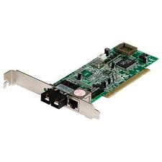
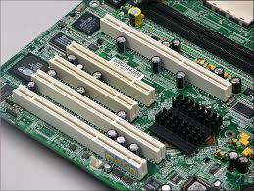
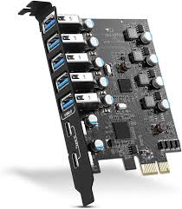
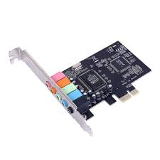
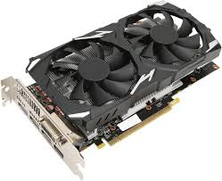
NIC card
USB card
PCI slot
Graphic card

Slide 15
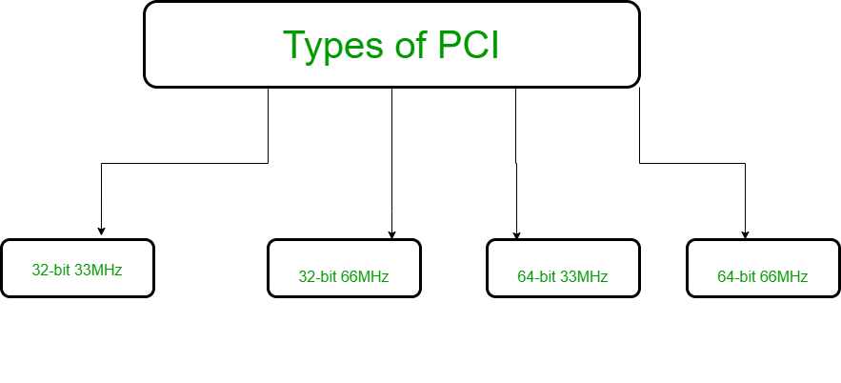
Types of PCI
PCI 32 bits have a transport speed of 33 MHz and work at 132 MBps.
PCI 64 bits have a transport speed of 33 MHz and work at 264 MBps.
PCI 32 bits have a transport speed of 66 MHz and work at 512 MBps.
PCI 64 bits have a transport speed of 66 MHz and work at 1 GBps.

Slide 16
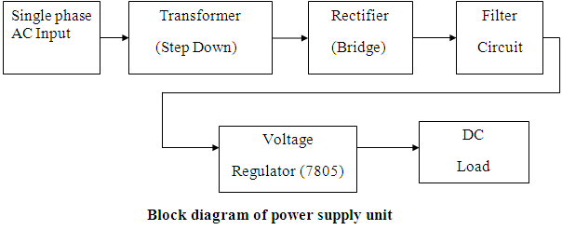
The internal Power supply
Power Supply is a hardware component that supplies power to an electrical device. It receives power from an electrical outlet and converts from AC to DC.
A power supply unit converts mains AC to low-voltage regulated DC power for the internal components of a computer. Modern personal computers universally use switched-mode power supplies. Some power supplies have a manual switch for selecting input voltage, while others automatically adapt to the mains voltage
There are different types of power supply. Some they are:
SMPS : Switch Mode Power Supply
UPS : Uninterruptible Power Supply
AC to DC supply converter

Slide 17
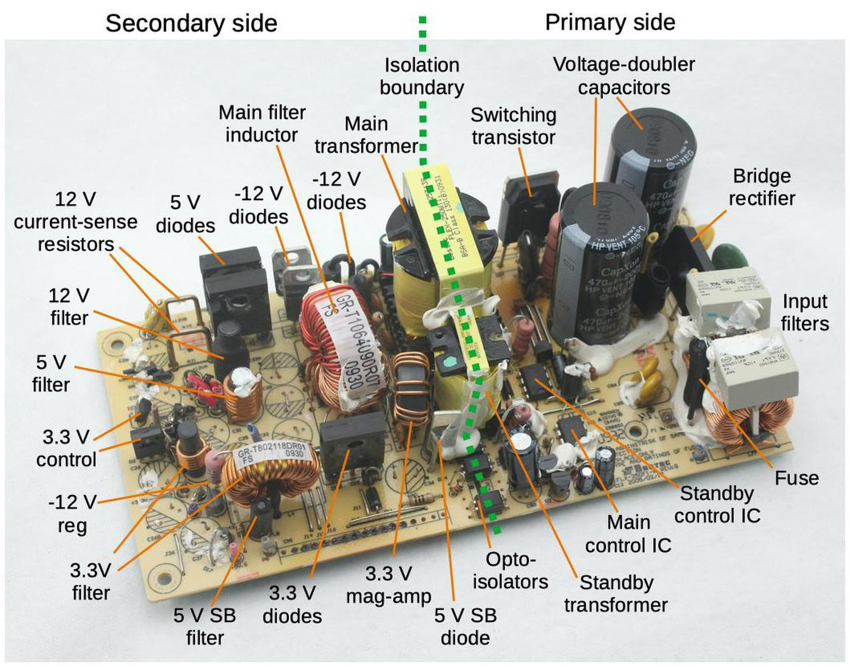
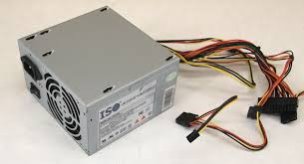
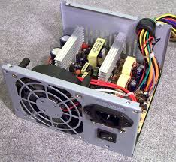

Slide 18
Parts of power supply
1. The Transformer
The transformer is used to step the AC voltage up and down. It transfers electrical energy between the primary winding and secondary winding, and it does so without changing the frequency. The transformer’s primary winding connects to the ac voltage source, while the secondary one correlates to the load.
2. The Rectifier
The rectifier is responsible for changing AC power to pulsating DC power. The basic rectifier is a diode — that is, a unidirectional device operating as a rectifier in the forward direction. Rectifier are employed in voltage multipliers, modulator and demodulator.
3. The Filter
The filter changes the pulsating DC produced by the rectifier to a smooth DC level. It suppresses ripple, which is the AC component in a signal following rectification. High ripples can damage the load. There are two main types of filters for power supplies: C-filters and RC-filters. C-filters are the simplest version of the two.

Slide 19
Parts of power supply
4. The Regulator Circuits
The voltage regulator helps ensure that the DC output voltage is stable regardless of any variation in the input voltage, which enables the load to operate properly. The most common types of regulators are the series voltage regulator and the shunt voltage regulator.
Other common parts are:
Inductors: Work with capacitors to filter out noise and further stabilize the voltage.
Control Circuit: Monitors and manages the PSU's functions, including protection against overvoltage, overcurrent, and short circuits.
Capacitors: Store and release electrical energy to help filter and stabilize the output voltage.

Slide 20
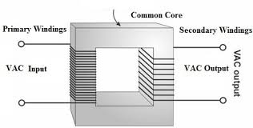
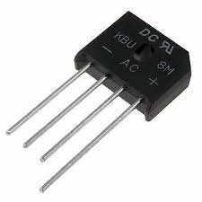
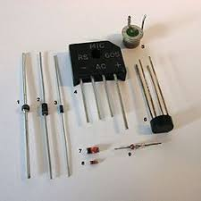
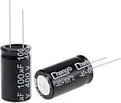
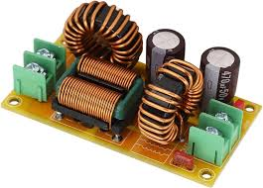
Rectifier
transformer
diode
capacitor
filter

Slide 21
Introduction to Hard Drive
Hard disk is the most common secondary storage device in the personal computer. It is also called the magnetic disk, HDD, fixed drive, or fixed disk. It is the main and the largest data storage device in the computer. It can store a large amount of data and information permanently. The storage capacity of hard disk ranges from 100's Gigabyte (GB) to some Terabytes (TB) such as 200 GB, 300 GB, 500 GB, 1 TB, 2 TB, 4 TB, etc. The first hard drive was introduced by IBM in 1956.
Types of hard disk :
Solid state disk (SSD, new hard disk), Mechanical Hard disk(magnetic disk), Mixed hard disk( modern hard disk)

Slide 22
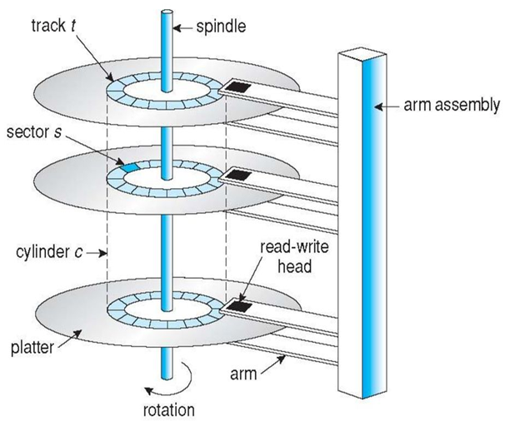
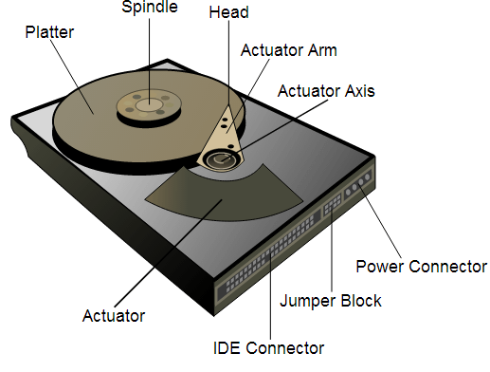
Introduction to Hard Drive
Fig: Hard Drive
Structure of hard disk

Slide 23
Components of an HDD
Platters: Disks coated with a magnetic material where data is stored. Typically, an HDD has multiple platters stacked on a spindle.
Spindle: The axis that holds the platters and spins them at high speeds, typically ranging from 5,400 to 7200 RPM (revolutions per minute).
Read/Write Heads: Tiny magnetic heads located on an actuator arm, responsible for reading data from and writing data to the platters.
Actuator Arm: Moves the read/write heads across the platters to access different data tracks.
Actuator: A motor that controls the movement of the actuator arm.

Slide 24
Components of an HDD
Heads:
The number of heads is relative to the total number of sides of all the platters used to store data. If a hard disk drive has four platters, it can have up to eight heads.
Track : Each surface of platter is divided into number of concentric rings is called track.
Cylinder: The collection of all track that are same distance from the edge of the platter is called cylinder.
Sector: Each track is further broken down into smaller units called sectors. As sector is the basic unit of data storage on a hard disk. The data size of a sector is always a power of two and is almost always either 512 MB.

Slide 25
Partitioning, partition size and Drive lettering
Partitioning:
A disk partition or partition is a section of a hard disk separate from other sections. Partitioning divides a hard drive into multiple logical storage units within one drive, but functions as multiple drives. Microsoft operating systems divide hard disks into drives. The first drive partition contains a drive called the primary drive, usually "C:", this is the active partition that boots the operating system." D:' and 'E:" has multiple drives and is used for other storage such as programs, data files, CD-ROMs, and USB drives. Some older versions of Unix OS such as Linux and Mac OS X use multiple partitions from secondary storage to disk. This is called a swap partition or paging.
Purpose of partitioning hard disk:
Use of New Hard Disk Ease of Windows Reinstallation
Better Organization Easier Backup
Simpler Data Recovery

Slide 26
Why we need partitioning in computer system?
Partitioning a hard disk is essential for several reasons:
Organization: It helps in organizing data by separating the operating system, applications, and personal files into different sections.
Performance: Partitions can improve performance by reducing the time needed to access files.
Backup and Recovery: It simplifies the process of backing up and recovering data, allowing users to restore specific partitions without affecting others.
Multiple Operating Systems: Partitions enable the installation of multiple operating systems on the same hard disk.
Security and Management: It enhances security and management by isolating sensitive data and making it easier to manage disk space.

Slide 27
Types of Partitions
Primary Partitions: These are the main partitions on a hard drive where you can install the OS. A hard drive can have up to four primary partitions. One of these partitions can be marked as active, from which the computer boots.
Extended Partitions: If more than four partitions are needed, one of the primary partitions can be designated as an extended partition. This extended partition can contain multiple logical partitions.
Logical Partitions: These reside within an extended partition. They are used to overcome the limitation of having only four primary partitions.

Slide 28
Partition size:
Partition size on a hard disk refers to the specific amount of disk space allocated to a particular partition. A partition is a defined segment of a hard disk's total storage capacity, and partitioning is the process of dividing a hard disk into one or more distinct regions. These partitions can be used to separate different types of data, run multiple operating systems, or manage storage more efficiently. Key concept of partition size are, total size, used and free space , maximum size etc.
Drive Letter:
A drive letter is a single alphabetic character A through Z that is assigned to a physical computer drive or drive partition. For example, floppy disk drive has a drive letter of A: and B: assigned to the drive computers containing hard drive always have that default hard drive assigned to a C: drive letter and the CD-ROM or another disc drive is the last drive letter (e.g. D: drive)

Slide 29
Formatting and types
Formatting:
Disk formatting is the process of preparing a data storage device such as a hard disk drive, solid-state drive, floppy disk, memory card or USB flash drive for initial use.
Format disk is erasing the operating system data from the disk and organizing the available space for further use. Formatting a disk will d
elete data and provide a new and blank disk. Usually, we can format a disk if we want to use a new system or if we need extra space in our drive.

Slide 30
How to perform formatting ?
Formatting a Disk on Windows
Backup Data:
  Ensure all important data on the disk is backed up.
Open Disk Management:
  Right-click on the Start button and select "Disk Management" or press Win + X and choose "Disk Management".
Select the Disk:
  In the Disk Management window, find the disk you want to format.
  Right-click on the partition you want to format and select "Format".
Configure Formatting Options:
  Choose the file system (e.g., NTFS, FAT32, exFAT).
  Enter a Volume Label (optional).
  Select the allocation unit size (usually, the default is fine).
  Choose whether to perform a quick format (recommended) or a full format.
Start Formatting:
  Click "OK" to start formatting. Confirm any warning messages that appear.

Slide 31
Advantages of formatting a disk
Formatting removes all data from the disk, like unused files, and virus or malware which can improve the performance of the storage device.
Formatting allows you to start fresh, error-free file system, which helps in better organization and file management.
Fixes file system errors and corruption, ensuring that the storage space is used efficiently.
Regular formatting can help in maintaining the disk’s health by preventing future errors and corruption.
Formatting allows to partition the disk as needed, optimizing the use of disk space for different types of data.

Slide 32
Formatting types
There are two types of formatting :
a. Low-level formatting:
Low-level formatting is a process of initializing a disk at the physical level, which includes the creation of tracks, sectors, and other physical parameters that define how data is stored on the disk. This type of formatting is typically performed by the manufacturer before the device is sold and is rarely necessary for end-users.
Advantages of Low-level formatting
It can sometimes help to fix physical issues with a disk, such as bad sectors or read/write errors.
Disadvantages of Low-level formatting
It is a complex process that should only be attempted by experienced users or professionals.

Slide 33
Formatting types
b.High-level formatting:
It is the process of creating an empty file system on a hard drive partition or logical volume and installing a boot sector on PC. Often performed quickly, sometimes called quick format. It erases hard drive data, generates boot information , initializes the FAT, and flags logical bad sector if the partition exists.
Advantages of High-level formatting
It is a simple process that can be performed by most users without any special expertise.
Disadvantages of High-level formatting
It erases all data from the disk, so it should be done with caution to avoid accidentally deleting important files.

